Slide 1

Adoption of ISA-95 as the foundation for an Automation Architecture
Eric C. Cosman
Engineering Services Functional Architect
The Dow Chemical Company

Slide 2
Abstract
Consistent and effective acquisition, development and application of Manufacturing Information systems require a well defined functional and technical architecture. An architecture that is based on established standards makes it easier to identify opportunities and to compare functions across suppliers and organizational boundaries. Although there are several approaches or methods that may be used to define and implement such an architecture, all depend on clearly articulated principles and a set of consistent set of concepts and models.
Principles must reflect the value system of the organization and as such will vary from one company to another. On the other hand, there are real benefits to having common conceptual models that can be applied across many companies and industries. These include improved communication efficiency and the more rapid adoption of basic functions that provide the basis for more value-added solutions.
This presentation describes the approach taken by The Dow Chemical Company in adopting the ANSI/ISA-95 standard as a basis for a Manufacturing Systems architecture. Although architecture development is an ongoing process, activities completed to date have resulted in real benefits while identifying challenges in several areas, ranging from specification development and procurement to system support.

Slide 3
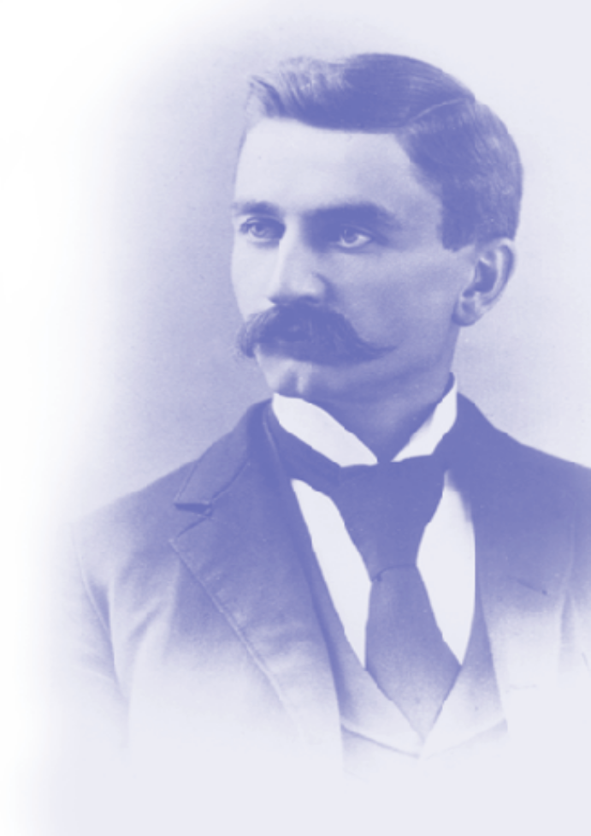
The Dow Chemical Company
Founded in 1897 by Herbert H. Dow in Midland, Michigan
Global science and technology company with annual sales of over $30 billion
Serves customers in more than 170 countries and a wide range of markets that are vital to human progress
Mission - “To constantly improve what is essential to human progress by mastering science and technology.”

Slide 4
Integrated Engineering Services
Service function within Manufacturing & Engineering
Delivers reliable, cost-effective, value-added engineering solutions to Dow Businesses
Scope includes process design, process automation and process safety
Definition of “Process Automation” generally consistent with industry standards
  Manufacturing Operations plus Process Control

Slide 5
Related Patents
The Dow Chemical Company holds the following U.S. patents on the subject of integration of Manufacturing and Business information systems:
  6,345,259 (System and method for integrating business and manufacturing environments)
  5,463,555 (System and method for integrating a business environment with a process control environment)
  6,141,647 (System and method for integrating a business environment, a process control environment, and a laboratory environment)

Slide 6
Messages
Standards are maturing and converging to provide a solid basis for a Manufacturing Systems Architecture, but…
  They are not enough by themselves.
Value is there now…
  But maybe not in the form that you would expect
Get Involved!
  Decisions are made by those who show up
There are no shortcuts…
  Prepare for the journey and take the time to define fundamentals

Slide 7
Topics
Foundation
Current Activity
Plans and Directions
Value Realized
Challenges
Where we have been…
Guiding philosophy
Strategic intent
Principles
Architecture in Dow

Slide 8

Guiding Philosophy
Go outside to get the best thinking on basic standards and solutions
Standardize processes and practices across the company - it saves time, eliminates errors and simplifies everything
Save valuable internal resources to focus
on optimizing these basic solutions across
specific businesses and processes

Slide 9
Strategic Intent
Design and implement lowest life-cycle cost automation solutions that maximize asset utilization and productivity with no unplanned process events.
Commercial products have the potential for significant productivity gains:
  Faster project implementation by using standardized object-oriented engineering
  Faster leveraging of technology with reusable objects
  Commercial platforms lower system development and support costs to Dow

Slide 10
Principles
Combine supplier and industry directions with current assessment (installed systems and requirements).
Use industry models as high level blueprints
Establish contracts with Businesses on paths to new solutions.
Base solutions on a balance of strategic relationships with chosen suppliers (recognizing that their visions are not totally complementary)
Investment and project decisions are based on a full economic life cycle analysis
Product and technology directions described in terms of the Technology lifecycle model

Slide 11
A Solid Foundation
Operational Excellence
(Asset Utilization, etc.)
Best Automation Solutions
Advanced, Basic & Safety Control Strategies
Integrated Engineering Data
Information Access & Presentation
Process Knowledge
Automated Best Practices
Connectivity Through Standard Networks
Business System Integration
Defined Migration Paths
Work Process Integration
Products & Technology from
Strategic Suppliers
Industry Standards
Dow Values, Knowledge and Experience in Automation
Notes:
Page <number>

Slide 12
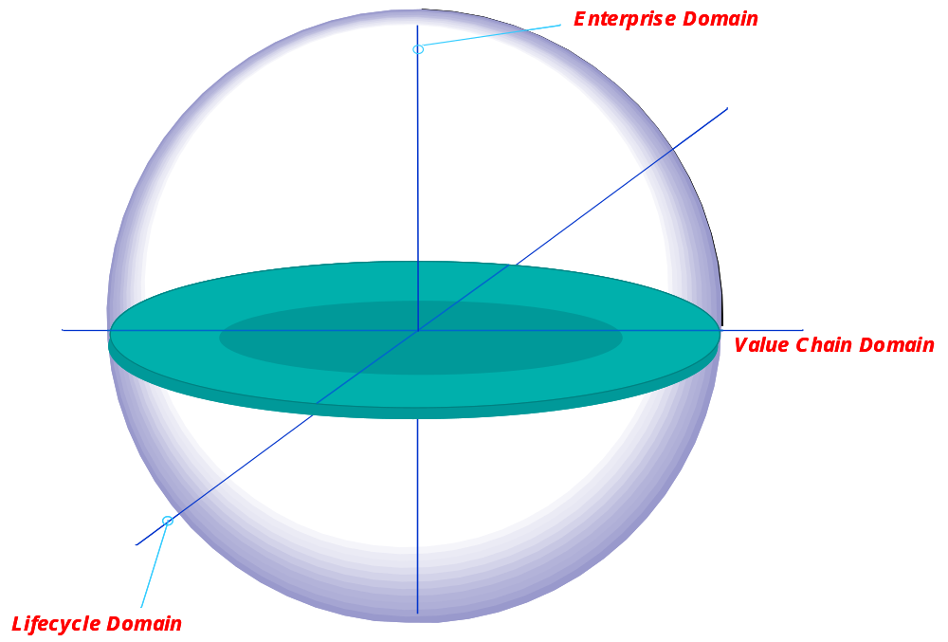
ARC Collaborative Mfg Model ^{(*)}
Enterprise Domain
Business Operations
Product & Process Support
Lifecycle
Domain
Our Current Focus
Supply-Side Materials Management
Internal Collaboration
Customer Order Fulfillment
Value Chain Domain
Product & Process Design, NPI
Plant/Factory Operations
^{(*)} Source: ARC – Used with permission

Slide 13
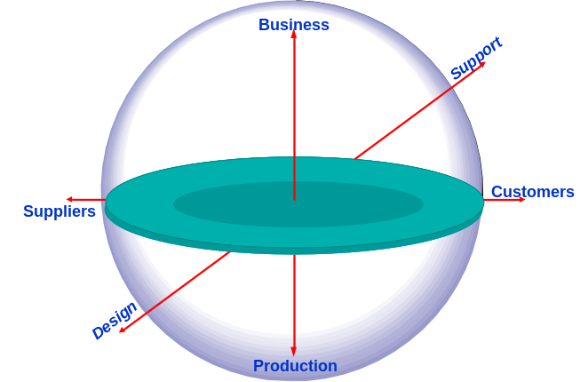
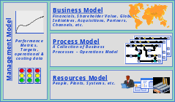


ARC Collaborative Mfg Model ^{(*)}
Business Processes
Service Based Infrastructure
Systems & Applications
Network & Systems Infrastructure
ISA-95 Touches on ALL of these elements
^{(*)} Source: ARC – Used with permission

Slide 14


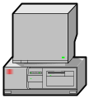
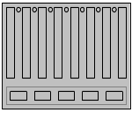
A New Perspective
From this…
To this…
Business Planning & Operations
Production Definition
Production Capability
Production Plan
Production Performance
Collaborative Process Automation System
Production Management
Continuous
Batch
Logic
Sensors, Actuators and Logical Devices
L
F
F
L
F
L
L
P
T
L
T
F
L
F
Source: ARC – Used with permission

Slide 15
Topics
Foundation
Current Activity
Plans and Directions
Value Realized
Challenges
What are we doing?
Basis
Method
Process
Areas of Focus

Slide 16
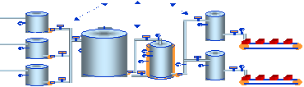
Basis
ISA-95
Levels
Production Definition
Production Capability
Production Plan
Production Information
3
.
.
2
.
.
1
.
.
0
Manufacturing
Operations
Production Management
Continuous
Batch
Discrete
Sensors, Actuators & Logical Devices
Process
Control

Slide 17
Method
Provide business scenarios to senior management as a basis for investment decisions.
Align technology introduction with business drivers (not vendor’s product cycles)
Position industry trends with a Dow perspective
Select optimum time to adopt new technology
  High Value - Early Adoption
  Low Cost - Late Adoption
Identify opportunities / drivers to eliminate obsolete technology

Slide 18
Process
feedback loop
Overall
IT Strategy
for Mfg
Business
Scenarios
Business
Planning
Process
Business
IT
Strategies
Business
Solutions
Plans
Business
Implementation
Plans
Program
Plan
Stage Gate
Program
Plan
Supplier
Portfolio
Plan
Program
Plan
update
Staging
&
Approval
Planning
Technology
Architecture
feedback loop
Notes:
Page <number>

Slide 19
Areas of Focus
Real-Time Performance Management
Process Systems Security
Integration of Engineering Disciplines
Standardization of Control Platforms
Integration with Enterprise Systems

Slide 20
Agenda
Foundation
Current Activity
Plans and Directions
Value Realized
Challenges
Next Steps?
Operational Excellence
Views on Integration
Convergence

Slide 21
ARC Collaborative Mfg Model ^{(*)}
Business Processes
Service Based Infrastructure
Systems & Applications
Network & Systems Infrastructure
^{(*)} Source: ARC – Used with permission

Slide 22
Response by Category
Business Processes
Revisions to reflect recent consolidations
Focus on Mfg and Supply Chain Links
Service Based Infrastructure
Identify common services
Address via corporate projects

Slide 23
Response by Category
Identify & eliminate overlaps
Life cycle approach to manage standard solutions
Address functional gaps
Systems & Applications
Network zone model
  security and operational support
Common technology
  collaboration between Mfg and IT
Network & Systems Infrastructure

Slide 24
Domains of Integration
Services
eMarket
Procurement
Document &
Business
Process
Oriented
HR
MRO
& Supplies
Non-Strategic
Indirect
EPC’s
Outsourced
Process
Freight
Surplus
Equipment
Request
Request
Reply
Reply
External Enterprise Integration Layer
ERP
CRM
SCM
Bus Reporting
Service Oriented Architecture
Data
Enterprise Core Applications
Transaction Oriented Architecture
Internal Enterprise Integration Layer
Domain Integration
Transaction
Oriented
Domain Integration
Application
Application
Domain Integration
Application
Application
Build
Maintain
Application
Application
Data Focused
Domain Integration
Mfg Operations
Data Focused
XML
Data Focused
Application
Application
Process Control
Performance Focused

Slide 25
Operational Excellence
Balanced Scorecard
Targets
Production Management
Operator Training & 6Sigma
Performance Management (Latent)
Work Process Mgmt Facility
Manufacturing Strategy Benchmarking
Abnormal Condition
Performance Business - Plant - Process
Quality LIMS
Maintenance
History
Continuous Improvement Benchmarking - Best Practices
Process Control & Monitoring
Progress & Performance Visualization
Trouble Shooting & Correction
Production Supervision (Real-Time)
Explicit Control & Transitioning
Performance Monitoring
Procedural Best Practices
Operational Perspective
Event Monitoring
Source: ARC Advisory Group (used with permission)

Slide 26
Data Integration
Simulatiuon
Cost Est.
P&ID’s
Intelligent
Schematics
Control strategy
Construction
Operations & Maintenance
Plant Modifications
Process
Design
Process
Automation
P&ID’s
Equip. Layout
Struct. Design
Cable Trays
Stress Analysis
Scheduling
Status
Inventory
Configuration Management
Est. / Scheduling
Plant Modification
Preventive / Predictive Maint.
Real-Time Data Capture
Regulatory Compliance
Detailed
Design
Process
Design
Apps
Automation
Apps
Detailed
Design
Apps
Construction
Apps
Operations & Maintenance
Plant Modifications
Apps
Common Information & Processes
Notes:
Page <number>

Slide 27
Convergence
Business Planning & Supply Chain Mgmt
Business Process transactions
Business Work Processes
Production Definition
Production Capability
Production Plan
Production Information
Process Automation
Manufacturing Work
Processes
Production Management transactions
Production Management
Real-Time Control & Events
Continuous
Batch
Logic
Sensors, Actuators & Logical Devices
Source: ARC Advisory Group
(used with permission)

Slide 28
S-95 Activity Model (Operations)
Product
definition
Production
capability
Production
schedule
Production
performance
Detailed
production
scheduling
Production
resource
management
Production
tracking
Production
dispatching
Production
Performance
analysis
Product
definition
management
Production
data
collection
Production
execution
Equipment & Process Specific Production Rules
Operational Commands & Responses
Equipment & Process Specific Data
Level 0-1-2 Process Control

Slide 29
A “Blended” Activity Model
Production
tracking
Production
dispatching
Production
Performance
analysis
Product
definition
management
Production
data
collection
Production
execution
Production Data Reporting
Operator Actions
Control Strategy Execution
BPCS
Batch Exec
SIS
Control Strategy Development
Inter-Controller Communication
Control Strategy Simulation
Field Network Communication

Slide 30
Observations
Basic Process Control is a commodity,
  but the information is not effectively applied
Enterprise Resource Planning is a given,
  but information flow externally is largely manual
Advanced manufacturing solutions and supply chain optimization opportunities:
  Manufacturing Execution Systems
  Logistic Systems
  Advanced Process Control
  Process Driven On-Line Analysis
  Performance Monitoring
  Supply Chain Optimization

Slide 31
Agenda
Foundation
Current State
Plans and Directions
Value Realized
Challenges Faced
Where is the Value found?

Slide 32
Sources of Value
Business Process Improvements
  It depends on where you are starting from
Portfolio Management
  Elimination of overlaps and redundancy
  A coherent investment plan over time
Planning and Coordination
  A common language and direction
  Less time spent arguing concepts
Access to “best thinking”
  The key is how you use it

Slide 33
Agenda
Foundation
Current State
Plans and Directions
Value Realized
Challenges Faced
What are we struggling with?
Internal Challenges
External Challenges
Responses Required

Slide 34
Internal Challenges
Diversity in current installed base
  remediation, coexistence, migration or replacement?
Establishing effective relationships
  internal and external
  “Relationship management”
Inadequate response to new risks introduced by tighter integration
“Disintegration” that may result from business process reassignments

Slide 35
External Challenges
Evolution of standards
  “broad enough to embrace; specific enough to implement”
  accelerate the process
  move from theory to practice
Evolution of Solutions and Technology
  address the “life cycle disconnect”
  “Open but secure”

Slide 36
Responses Required
Open systems and standard technology
  Each component must be able to communicate with any other component.
  “full competition in price and technology”
Security
Modular components
  incremental implementation, ease of migration
Innovation cycles adjusted to the lifetime of the production units
Technology must concentrate more on operational needs
  fewer features and more focus

Slide 37
Messages
Standards are maturing and converging to provide a solid basis for a Manufacturing Systems Architecture, but…
  They are not enough by themselves.
Value is there now…
  But maybe not in the form that you would expect
Get Involved!
  Decisions are made by those who show up
There are no shortcuts…
  Prepare for the journey and take the time to define fundamentals

Slide 38
Thank you
Eric C. Cosman
Engineering Services Functional Architect
The Dow Chemical Company
eccosman@dow.com

